Slide 1

Message encryption and decryption
DEPARTMENT OF COMPUTER SCIENCE AND ENGINEERING
(SUPERVISOR: MS. SURBHI JHA)

Slide 2

Team members
NAME
ROLL NO.
ROLE
SHAKIL UR REHMAN
2101330100205
PPT+CODING
SANDEEP SOLANKI
2101330100200
CODING
SIMRAN UPADHYAY
2101330100222
CODING

Slide 3
INDEX
INTRODUCTION
PROPOSED SYSTEM
LITERATURE SURVEY
IMPLEMENTATION OF CODE
RESULTS
SUMMARY

Slide 4
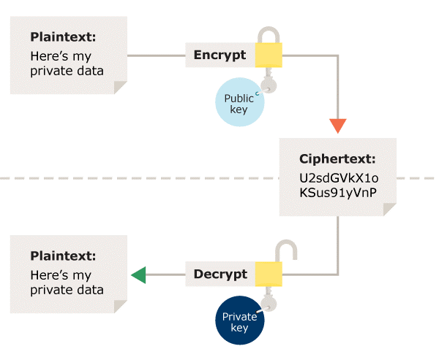
INTRODUCTION
Encryption is the process by which a readable message is converted to an unreadable form to prevent unauthorized parties from reading it.
Decryption is the process of converting an encrypted message back to its original (readable) format.

Slide 5
PROPOSED SYSTEM
HARDWARE REQUIREMENTS
PROCESSOR – Core i5
RAM MEMORY – 4GB
LAPTOP OR DESKTOP
SOFTWARE REQUIREMENTS
Windows 7 or higher
Python
Eclipse IDE

Slide 6
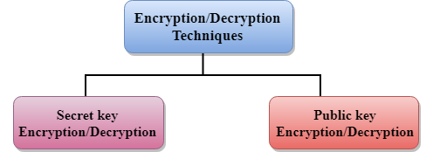
LITERATURE SURVEY
The concept of how to achieve privacy has not been changed for thousands of years: the message cannot be encrypted. The message must be rendered as opaque to all the unauthorized parties. A good encryption/decryption technique is used to achieve privacy to some extent. This technique ensures that the eavesdropper cannot understand the contents of the message.
The data which is to be encrypted at the sender site is known as plaintext, and the encrypted data is known as ciphertext. The data is decrypted at the receiver site.

Slide 7
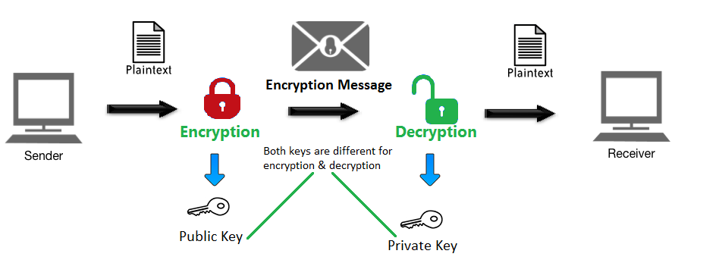
PICTORIAL REPRESENTATION

Slide 8
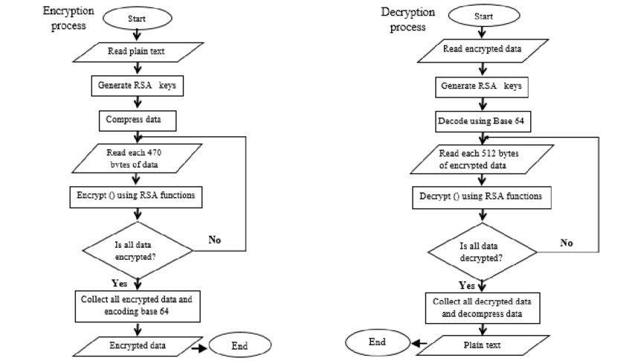
FLOWCHART

Slide 9
SOURCE CODE

Slide 10
Creating Root Window
# import tkinter module
from tkinter import *
# import other necessary modules
import random
import time
import datetime
# creating root object
root = Tk()
# defining size of window
root.geometry("1600x8000")
# setting up the title of window
root.title("Message Encryption and Decryption")
Tops = Frame(root, width = 1600, relief = SUNKEN)
Tops.pack(side = TOP)
f1 = Frame(root, width = 800, height = 700,
relief = SUNKEN)
f1.pack(side = LEFT)

Slide 11
Time and exit function
localtime = time.asctime(time.localtime(time.time()))
lblInfo = Label(Tops, font = ('helvetica', 50, 'bold’),
text = "SECRET MESSAGING \n Cipher",
fg = "Black", bd = 10, anchor='w')
lblInfo.grid(row = 0, column = 0)
lblInfo = Label(Tops, font=('arial', 20, 'bold'),
text = localtime, fg = "Steel Blue",
bd = 10, anchor = 'w')
lblInfo.grid(row = 1, column = 0)
rand = StringVar()
Msg = StringVar()
key = StringVar()
mode = StringVar()
Result = StringVar()
# exit function
def qExit():
root.destroy()

Slide 12
Function to reset the window
def Reset():
rand.set("")
Msg.set("")
key.set("")
mode.set("")
Result.set("")
# reference
lblReference = Label(f1, font = ('arial', 16, 'bold'),
text = "Name:", bd = 16, anchor = "w")
lblReference.grid(row = 0, column = 0)
txtReference = Entry(f1, font = ('arial', 16, 'bold'),
textvariable = rand, bd = 10, insertwidth = 4,
bg = "powder blue", justify = 'right')
txtReference.grid(row = 0, column = 1)

Slide 13
lblMsg = Label(f1, font = ('arial', 16, 'bold’), text = "MESSAGE", bd = 16, anchor = "w") lblMsg.grid(row = 1, column = 0) txtMsg = Entry(f1, font = ('arial', 16, 'bold'), textvariable = Msg, bd = 10, insertwidth = 4, bg = "powder blue", justify = 'right') txtMsg.grid(row = 1, column = 1) lblkey = Label(f1, font = ('arial', 16, 'bold'),text = "KEY", bd = 16, anchor = "w") lblkey.grid(row = 2, column = 0) txtkey = Entry(f1, font = ('arial', 16, 'bold'),textvariable = key, bd = 10, insertwidth = 4,bg = "powder blue", justify = 'right') txtkey.grid(row = 2, column = 1) lblmode = Label(f1, font = ('arial', 16, 'bold'),text = "MODE(e for encrypt, d for decrypt)",bd = 16, anchor = "w“) lblmode.grid(row = 3, column = 0) txtmode = Entry(f1, font = ('arial', 16, 'bold'), textvariable = mode, bd = 10, insertwidth = 4, bg = "powder blue", justify = 'right') txtmode.grid(row = 3, column = 1) lblService = Label(f1, font = ('arial', 16, 'bold'), text = "The Result-", bd = 16, anchor = "w") lblService.grid(row = 2, column = 2) txtService = Entry(f1, font = ('arial', 16, 'bold'), textvariable = Result, bd = 10, insertwidth = 4, bg = "powder blue", justify = 'right') txtService.grid(row = 2, column = 3)
Labels

Slide 14
Function to encode
def encode(key, clear):
enc = []
for i in range(len(clear)):
key_c = key[i % len(key)]
enc_c = chr((ord(clear[i]) +
ord(key_c)) % 256)
enc.append(enc_c)
return base64.urlsafe_b64encode("".join(enc).encode()).decode()

Slide 15
Function to decode
def decode(key, enc):
dec = []
enc = base64.urlsafe_b64decode(enc).decode()
for i in range(len(enc)):
key_c = key[i % len(key)]
dec_c = chr((256 + ord(enc[i]) -
ord(key_c)) % 256)
dec.append(dec_c)
return "".join(dec)
def Ref():
print("Message= ", (Msg.get()))
clear = Msg.get()
k = key.get()
m = mode.get()
if (m == 'e'):
Result.set(encode(k, clear))
else:
Result.set(decode(k, clear))

Slide 16
Buttons
btnTotal = Button(f1, padx = 16, pady = 8, bd = 16, fg = "black", font = ('arial', 16, 'bold'), width = 10, text = "Show Message", bg = "powder blue", command = Ref).grid(row = 7, column = 1)
# Reset button
btnReset = Button(f1, padx = 16, pady = 8, bd = 16,fg= "black", font = ('arial', 16, 'bold'), width = 10, text = "Reset", bg = "green", command = Reset).grid(row = 7, column = 2)
# Exit button
btnExit = Button(f1, padx = 16, pady = 8, bd = 16, fg = "black", font = ('arial', 16, 'bold'),
width = 10, text = "Exit", bg = "red", command = qExit).grid(row = 7, column = 3)
# keeps window alive
root.mainloop()

Slide 17
Final snapshot

Slide 18
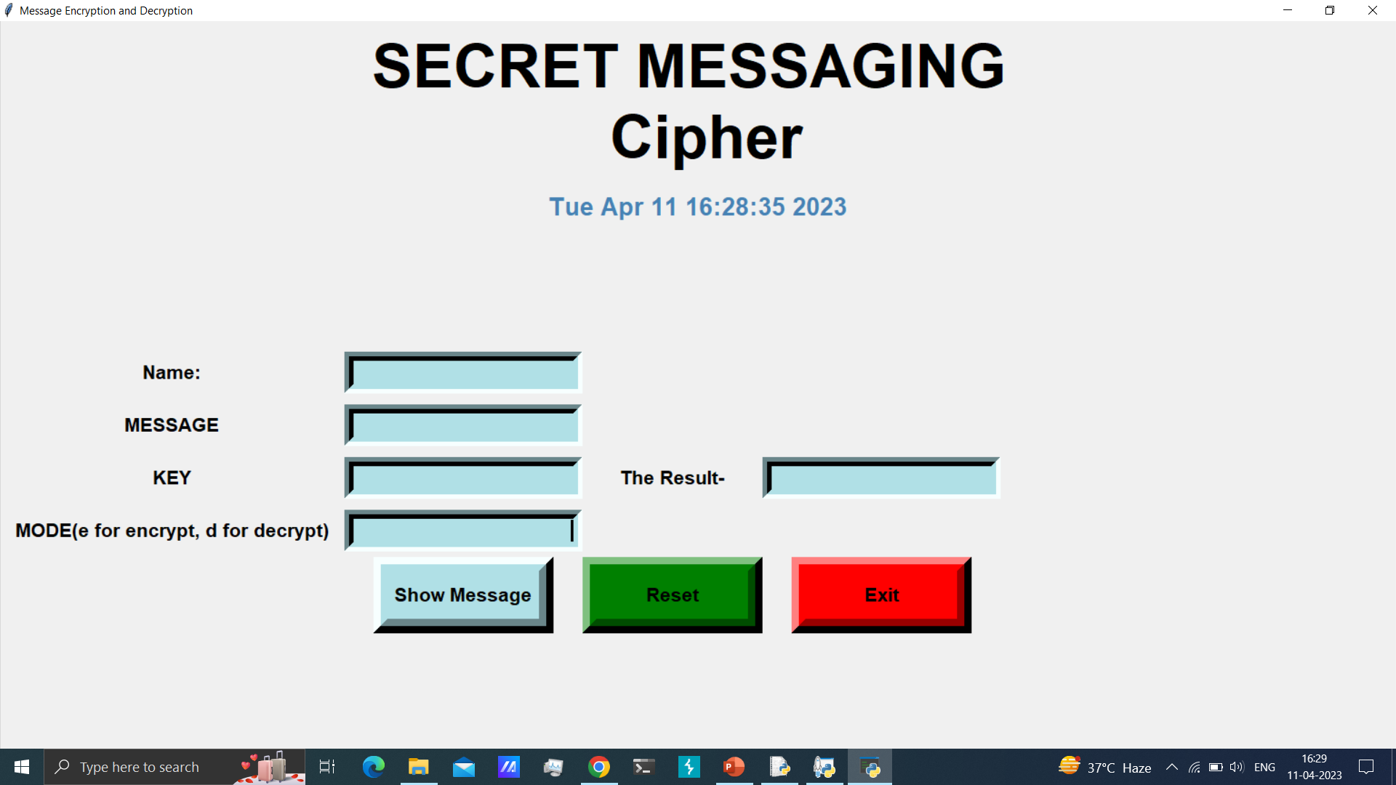
FIRST INTERFACE

Slide 19

ENCODING

Slide 20
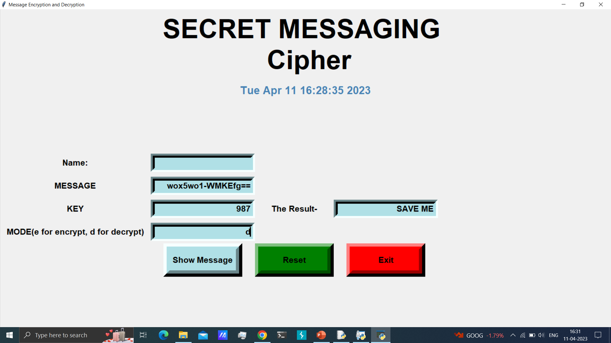
DECODING

Slide 21
Summary
IN THIS PROJECT WE TRIED TO BUILD A GUI INTERFACE USING WHICH A USER CAN ENCRYPT MESSAGE AND CAN DECRYPT IT USING SPECIFIC KEY.

Slide 22




Thank you
SHAKIL UR REHMAN
SANDEEP SOLANKI
SIMRAN UPADHYAY

